Slide 1
course registration database.
Shansi Dong
A20466369

Slide 2
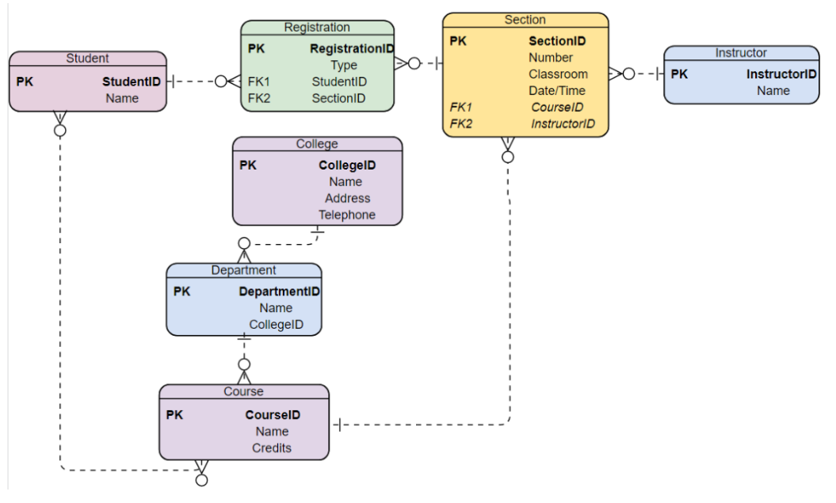

Slide 3
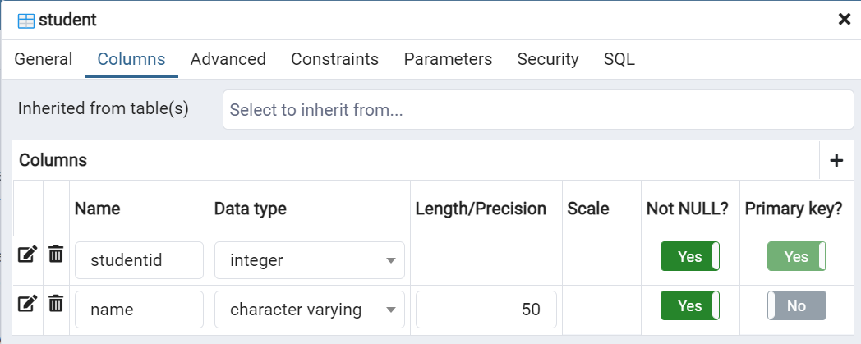
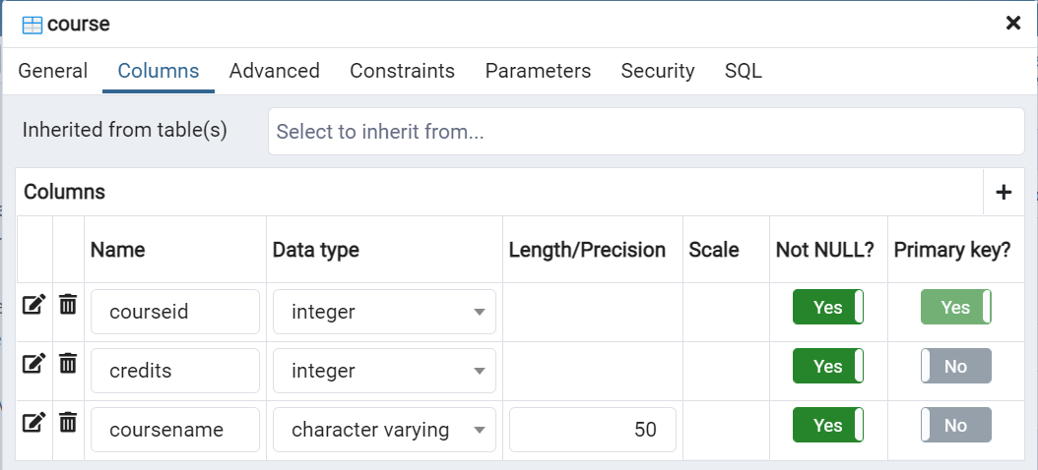

Slide 4
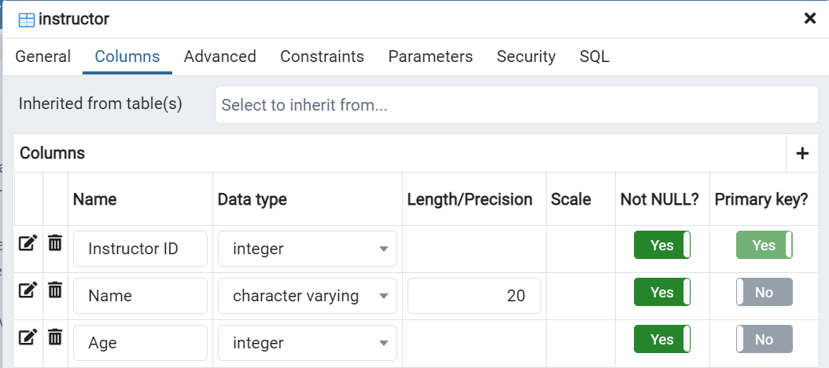

Slide 5
1. Create at least one or two tables of the HW2 design
CREATE TABLE student(
studentid INT PRIMARY KEY NOT NULL,
name VARCHAR(50) NOT NULL
);
CREATE TABLE course(
courseid INT PRIMARY KEY NOT NULL,
coursename VARCHAR(50) NOT NULL,
credits INT NOT NULL
);

Slide 6
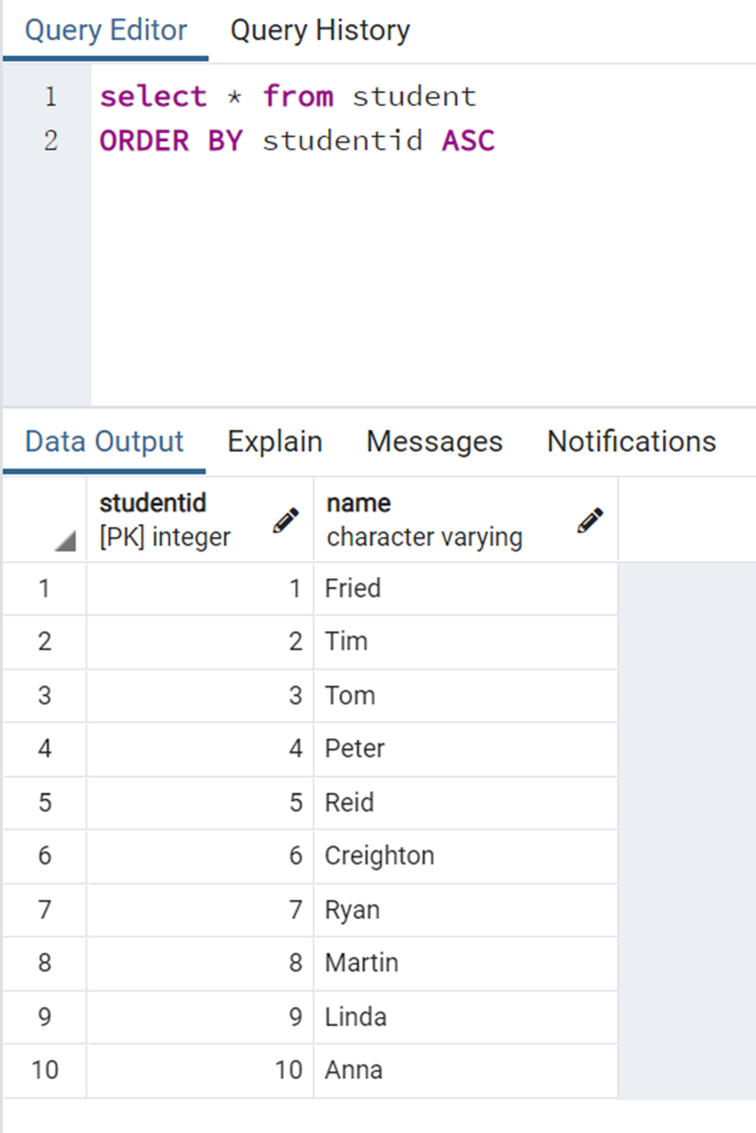
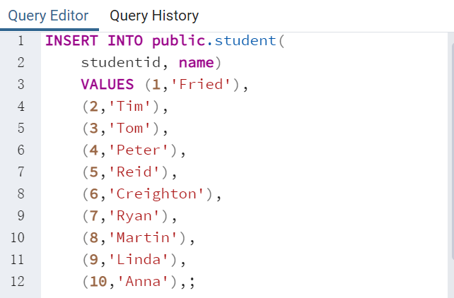
2. Insert at least 10 records (rows) into each table using SQL queries.

Slide 7
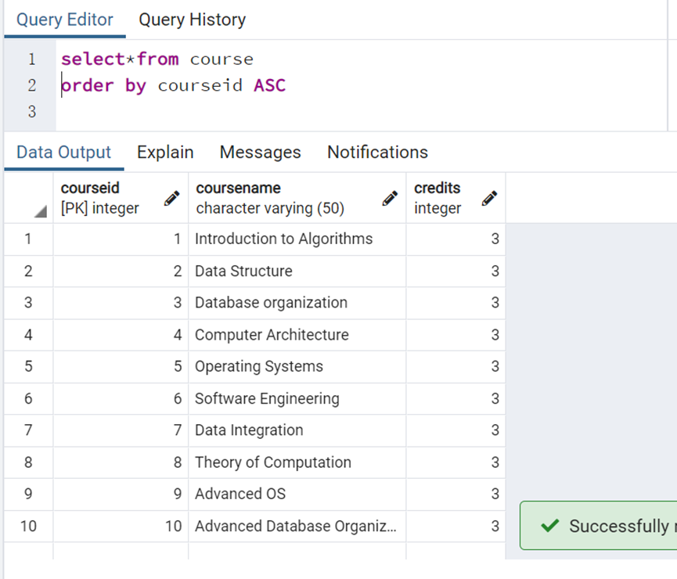
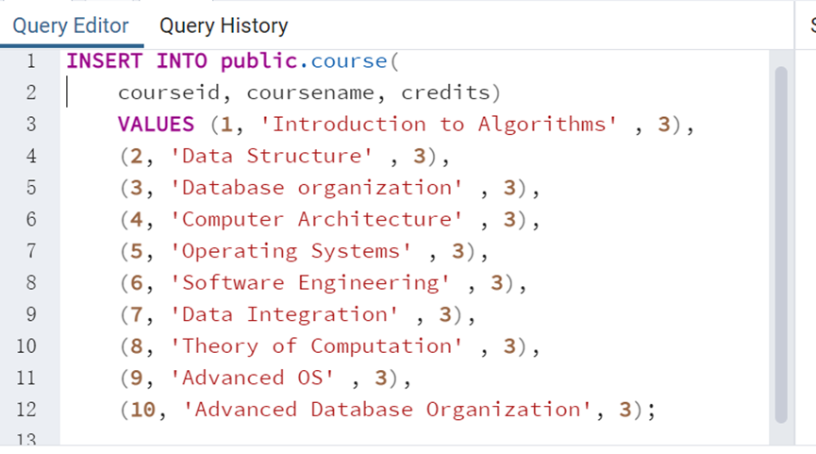
2. Insert at least 10 records (rows) into each table using SQL queries.

Slide 8
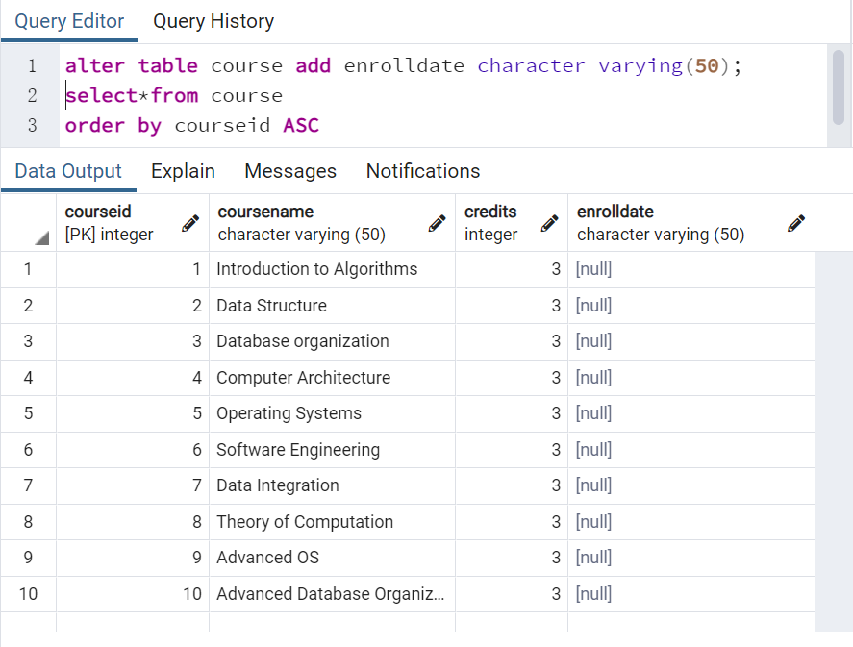
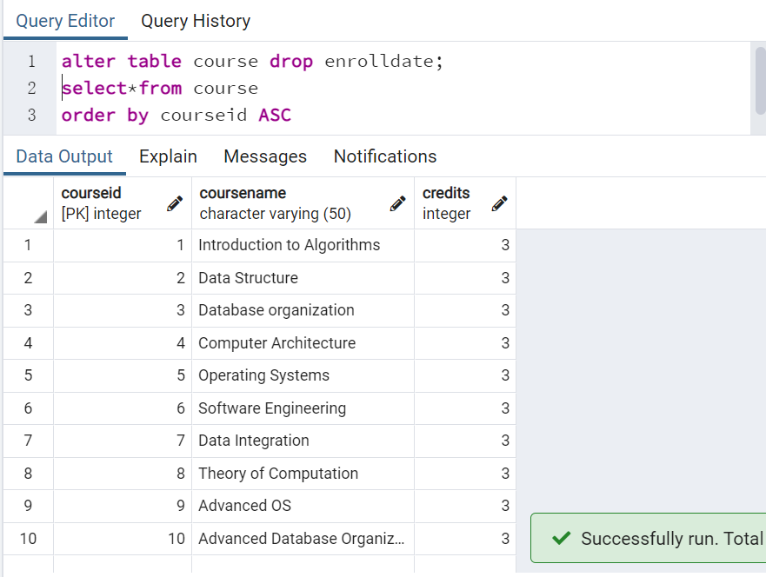
3. Modify (add and delete) columns of a table using SQL queries

Slide 9
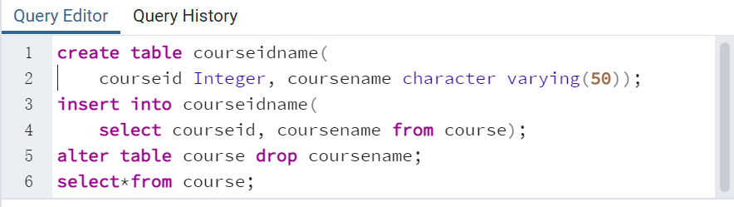
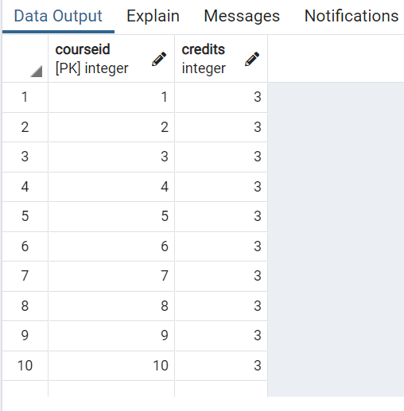
4. Delete a column of a table using SQL queries. 5. Restore the deleted column to the table by item 4 using SQL queries.

Slide 10
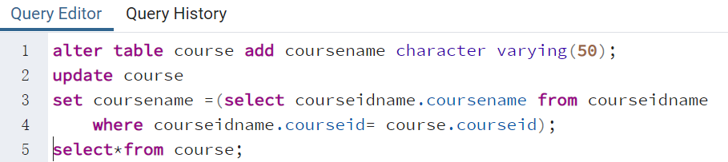
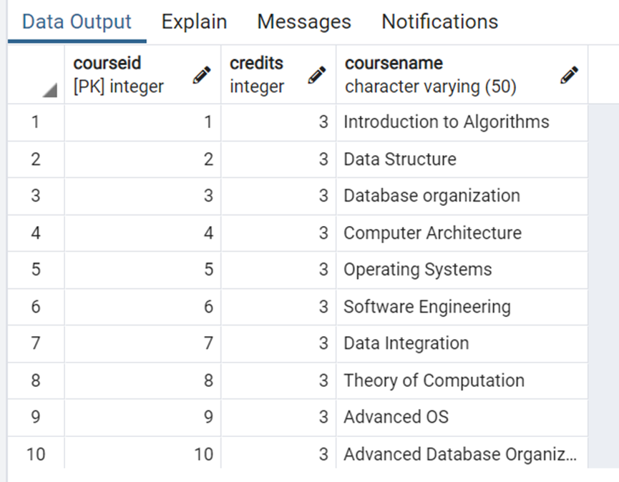
4. Delete a column of a table using SQL queries. 5. Restore the deleted column to the table by item 4 using SQL queries.

Slide 11
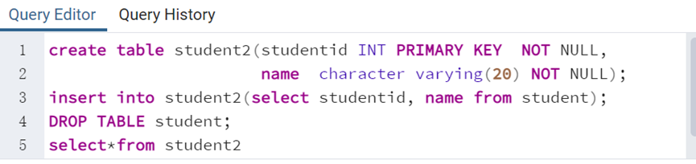
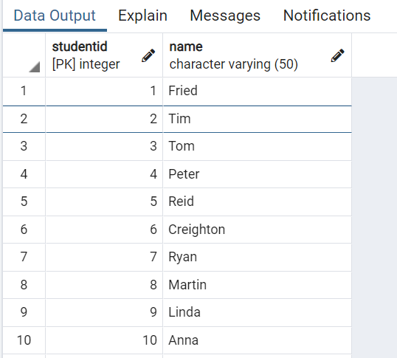
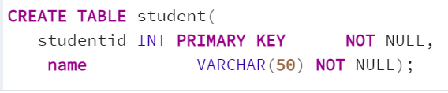
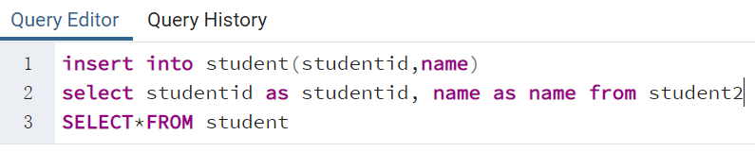
6. Remove one table using SQL queries. 7. Restore the removed table by item 6 using SQL queries.

Slide 12
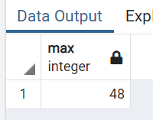
8. Create at least 10 different queries to search data using a table.
SELECT* FROM student；
SELECT *FROM course WHERE credit >= 2;
SELECT DISTINCT courseid，coursename FROM course;
SELECT name,COUNT(name) FROM STUDENT GROUP BY name;
SELECT name,age FROM instructor WHERE ORDER BY GRADE DESC LIMIT 1;
SELECT AVG(age) FROM instructor;
SELECT MAX(age) FROM instructor;
SELECT MIN(age) FROM instructor;
select length(name) from student；
SELECT *FROM instructor WHERE age BETWEEN 35 AND 45;

Slide 13
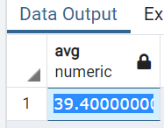
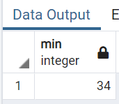
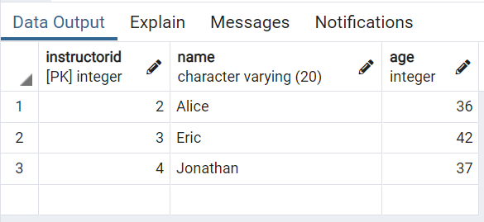
8. Create at least 10 different queries to search data using a table.
SELECT* FROM student；
SELECT *FROM course WHERE credit >= 2;
SELECT DISTINCT courseid，coursename FROM course;
SELECT name,COUNT(name) FROM STUDENT GROUP BY name;
SELECT name,age FROM instructor WHERE ORDER BY GRADE DESC LIMIT 1;
SELECT AVG(age) FROM instructor;
SELECT MAX(age) FROM instructor;
SELECT MIN(age) FROM instructor;
select length(name) from student；
SELECT *FROM instructor WHERE age BETWEEN 35 AND 45;

Slide 14
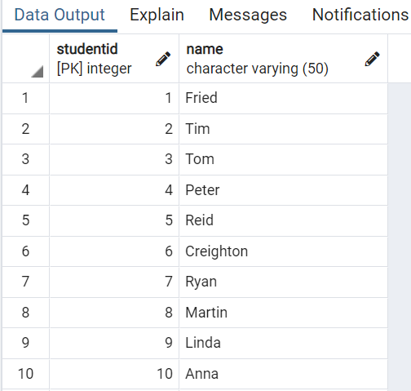
8. Create at least 10 different queries to search data using a table.
SELECT* FROM student；

Slide 15
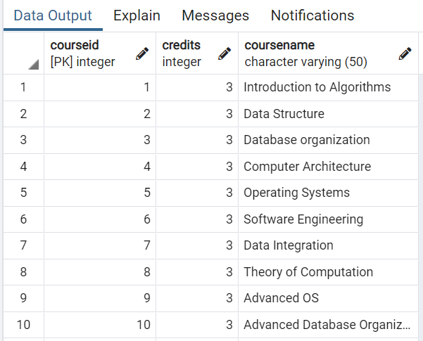
8. Create at least 10 different queries to search data using a table.
2. SELECT *FROM course WHERE credits >= 2;

Slide 16
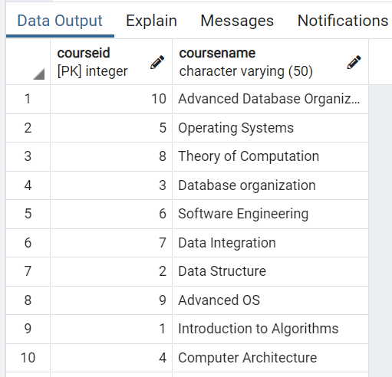
8. Create at least 10 different queries to search data using a table.
3.SELECT DISTINCT courseid,coursename FROM course;

Slide 17
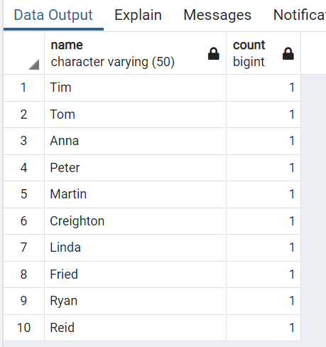
8. Create at least 10 different queries to search data using a table.
4.SELECT name,COUNT(name) FROM student GROUP BY name;

Slide 18
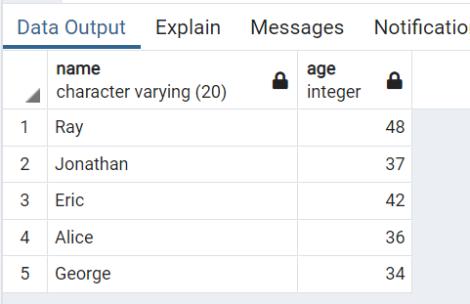
8. Create at least 10 different queries to search data using a table.
5.SELECT name,age FROM instructor ORDER BY instructorid DESC;

Slide 19
8. Create at least 10 different queries to search data using a table.
6.SELECT AVG(age) FROM instructor;
7.SELECT MAX(age) FROM instructor;
8.SELECT MIN(age) FROM instructor;

Slide 20
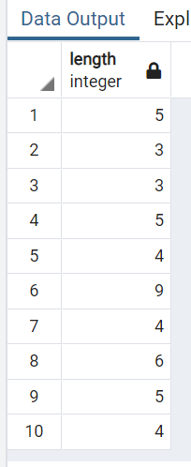
8. Create at least 10 different queries to search data using a table.
9.select length(name) from student；
10.SELECT *FROM instructor WHERE age BETWEEN 35 AND 45;

